Slide 1

Drvr
Freude am Fahren

Slide 2
Presentation Timeline
Today’s coverage
Purpose and target market
Design Methodology
Deployment Environment
Development Environment
Technologies Used
Introduction

Slide 3
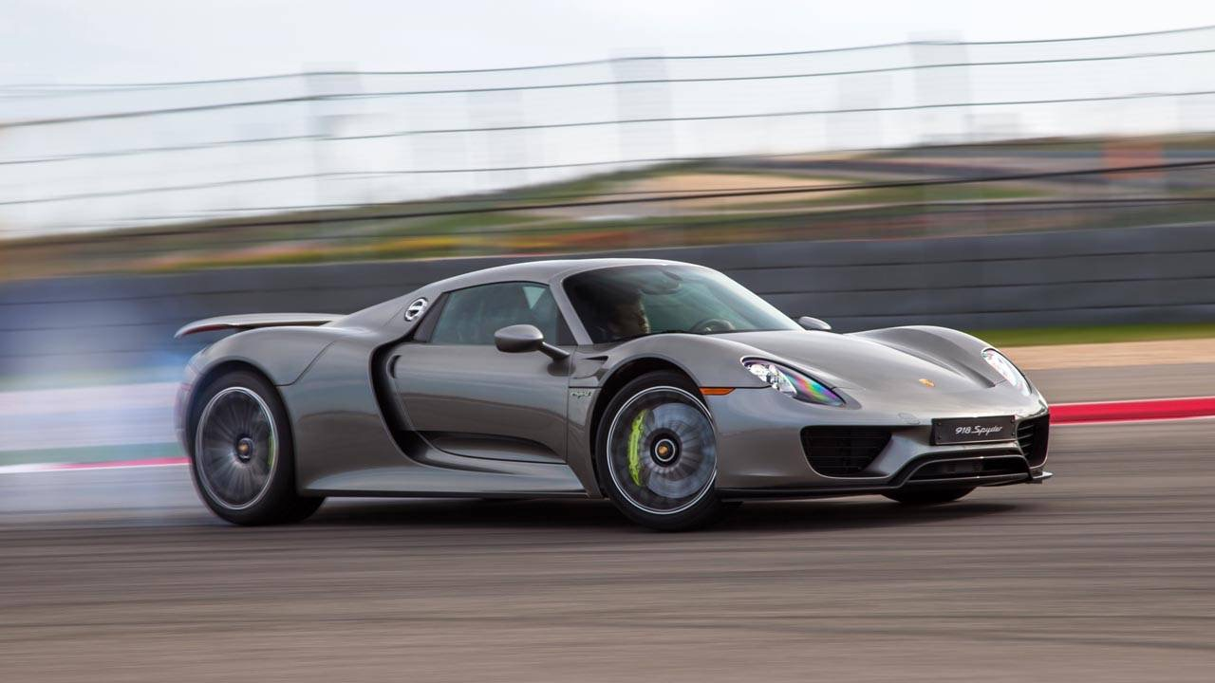
About
03
Say hello to the future of learning to about cars
A fun way to learn about the automobile
Notes:
Fun, easy and effective

Slide 4


Our Philosophy
04
01
The way we roll
“Rethink the way you drive. “
Fun
Ease of use
Effective learning
Notes:
Fun + Easy to use = effective learning + wider user base

Slide 5

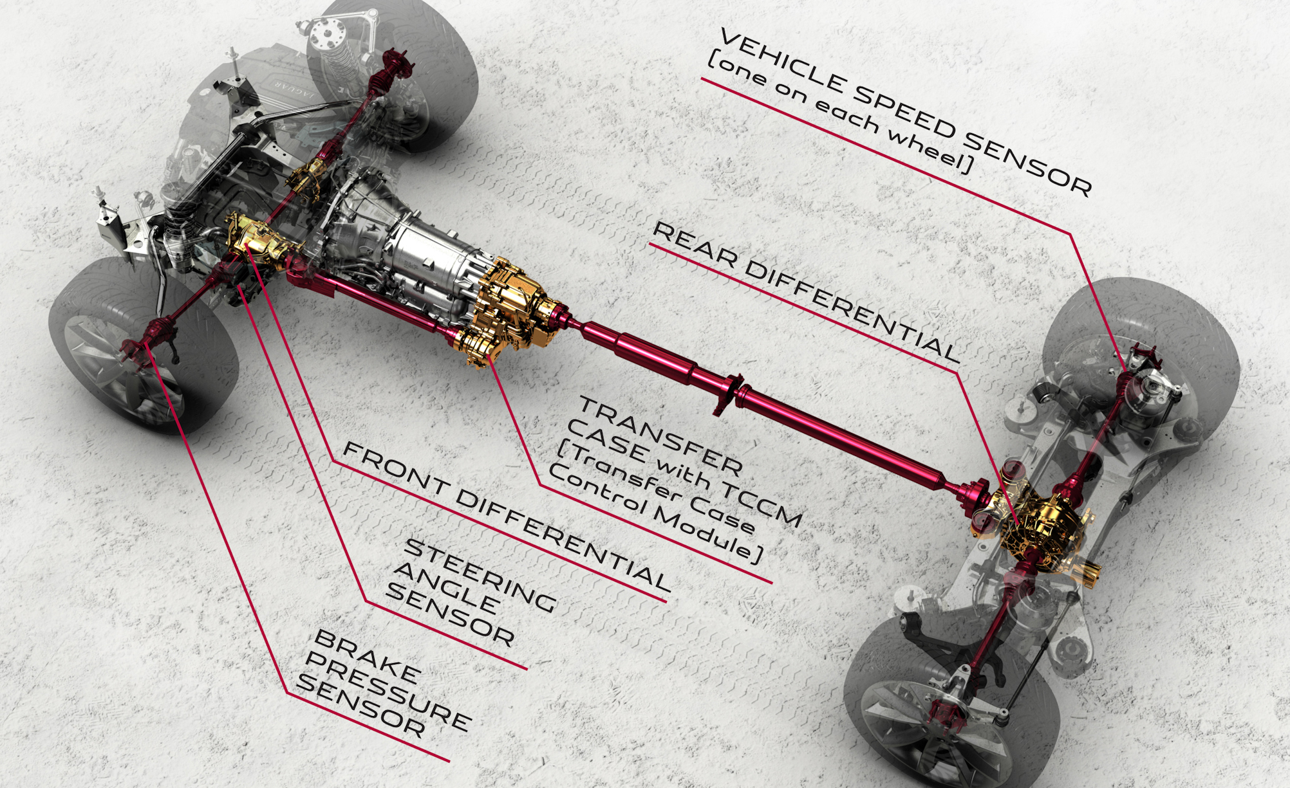
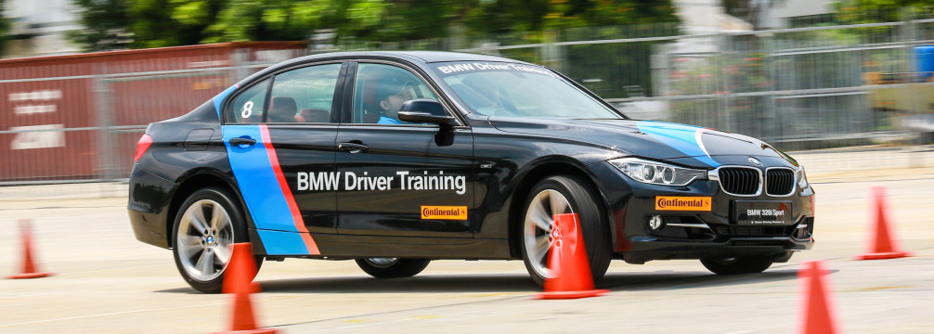

Target Market
05
01
Focussed at the target
Existing drivers who want to refresh their knowledge on cars
New Drivers
Notes:
Mainly for people who want to learn things about cars (ie: knowing the various terms about cars, and how the parts work together)
Done via interaction with a cutaway of the car, simulation and quizzes

Slide 6
Design Methodology
06
01
Designing and building excellence
Writing the code to for the specific functionality
Programming
Research and development to see how we would be able to implement the feature
Testing code to ensure it meets the quality standards set
Research
Testing
Brainstorm
Release
Brainstorm features that could be added to the system
Release the feature out, begin work on next feature
If there are changes in requirements we cant work on it in the next cycle
Notes:
Spiral : Brainstorm, research, program, test, release
Requirement changes; next cycle

Slide 7
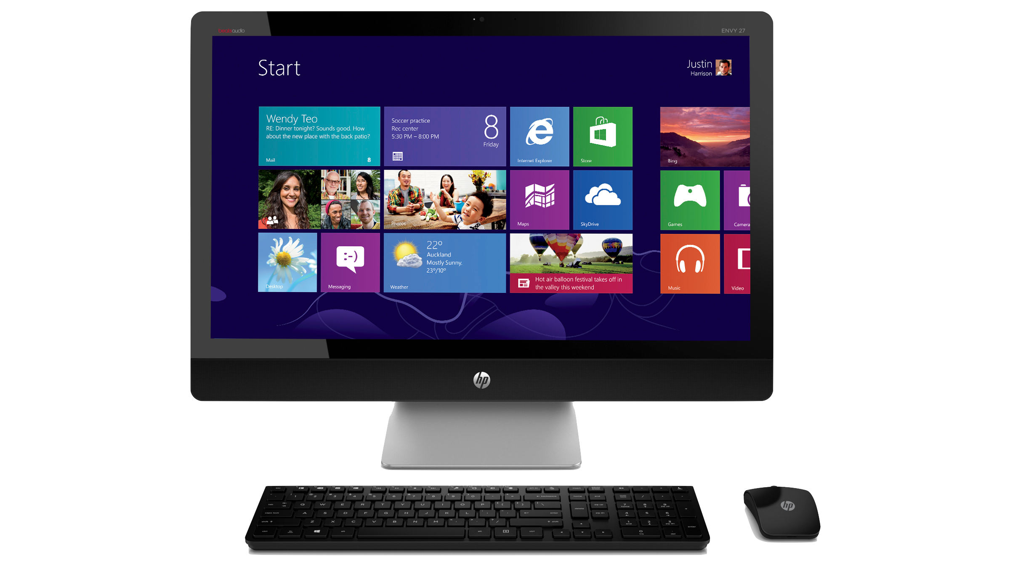

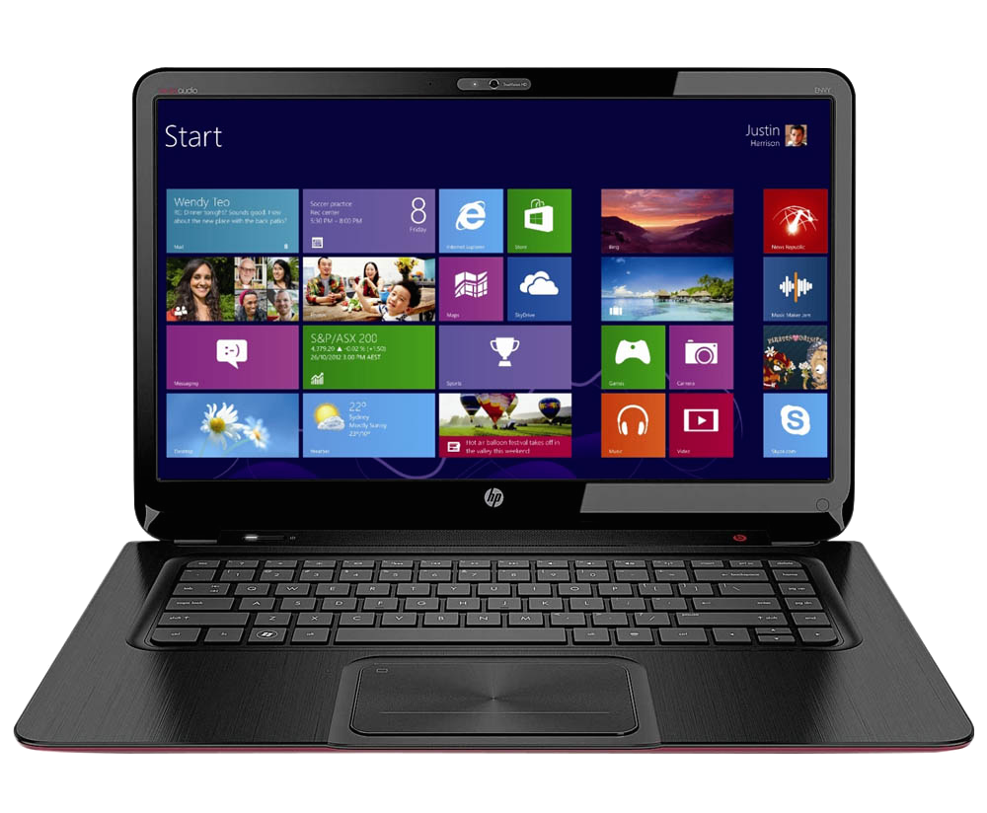
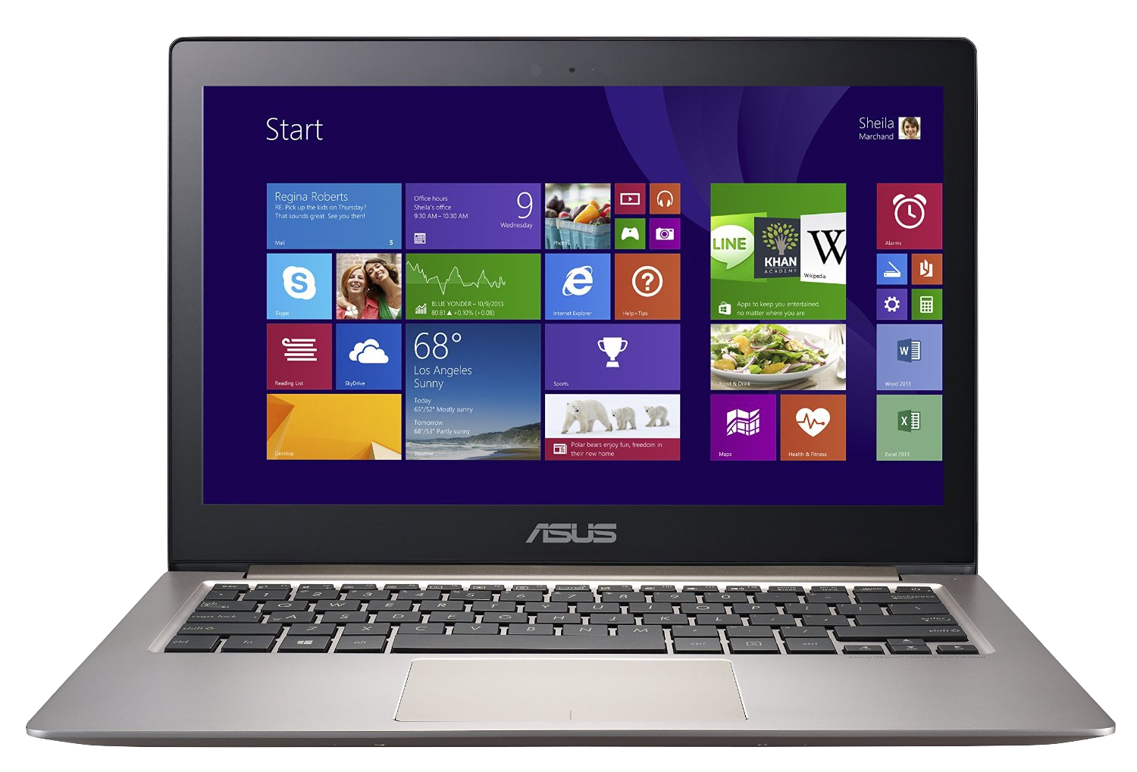
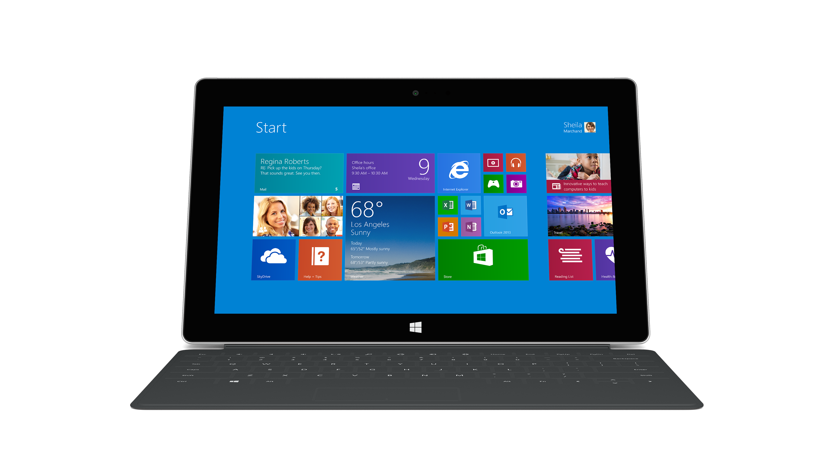
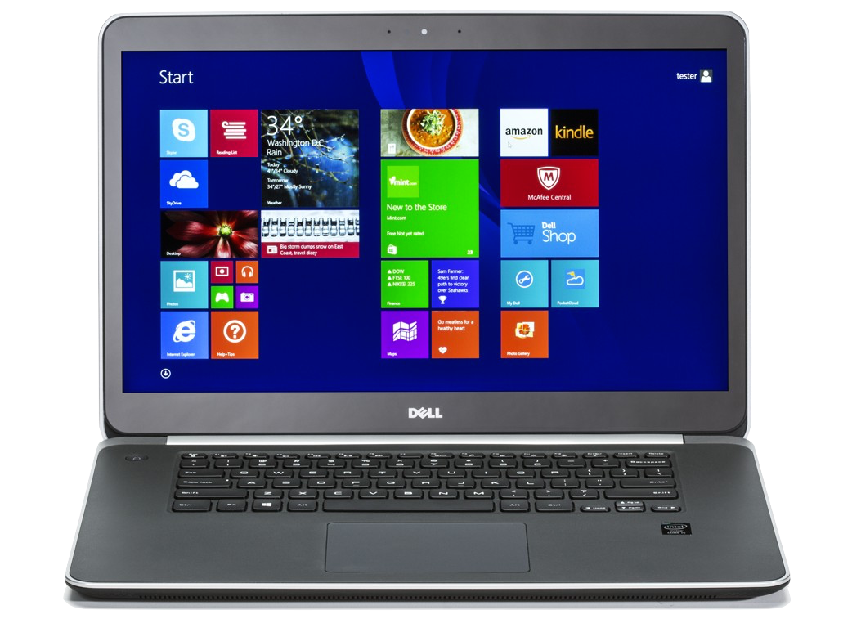
Deployment Model
07
01
The cutting edge future. Delivered.
Windows 8 and above
Notes:
Solo desktop application

Slide 8




Development Environment
08
01
We built this.
More functionality compared to Visual Basic
Large Development Community
Visual Studio 2013
Free*
More user friendly compared to Qt
Support for Visual C++
*free for students in university
Notes:
Good support, support V C++, Free.
More fx than VB, easier to use than Qt

Slide 9

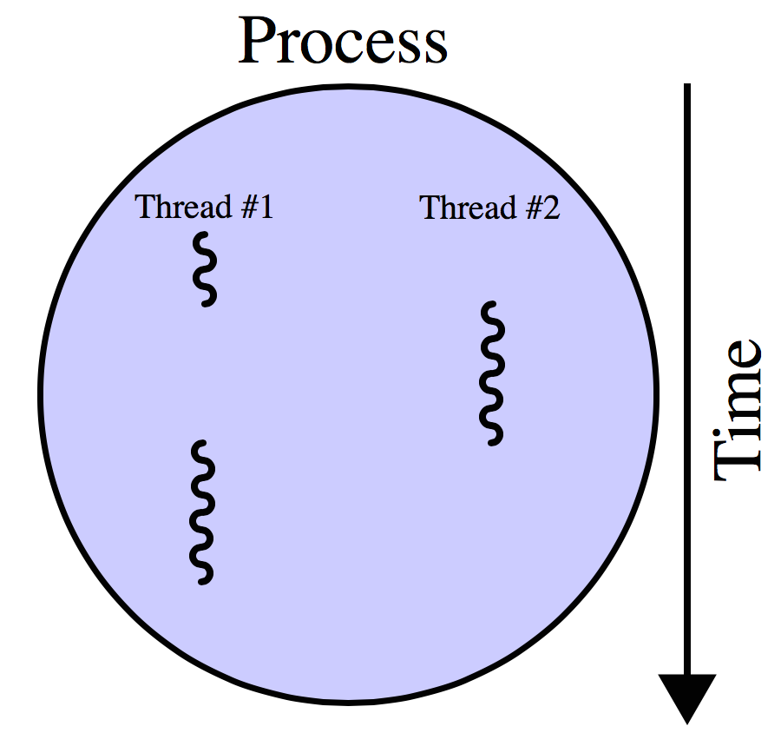

Technologies
09
01
At the forefront
Git repository
Multithreading
For version control purposes
Allows each component of the car being simulated to run individually
We aren't using a game engine due to our lack of expertise in game engines, and it would take too long to master it, hence potentially limiting the features we would be able to deliver
C++
For object orientated programming with full controls
Notes:
Git Version control
C++ full features obj oriented programming – VS2013 supported
Each part of the car should be thread, parts run individually - show that it is a distributed system
Not doing game engine due to lack of expertise, too long time to master. Limits features

Slide 10
Good Bye
Thank you for your time

